Slide 1


Data Visualizer manual

Slide 2
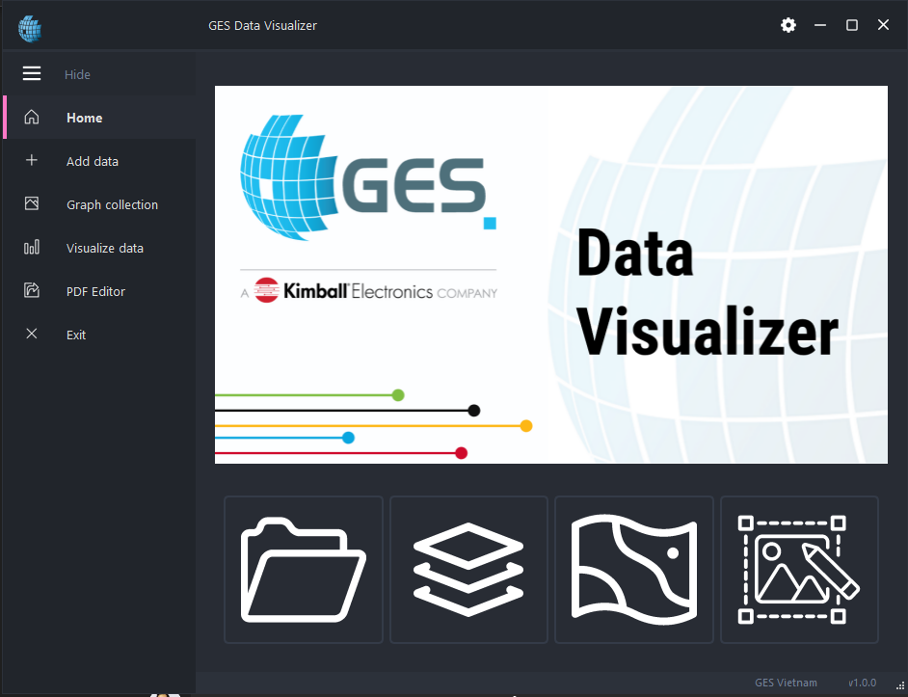
Interface
Navigation panel
Shortcuts
Add data
Plot surface
Plot heatmap
PDF editor
Version

Slide 3
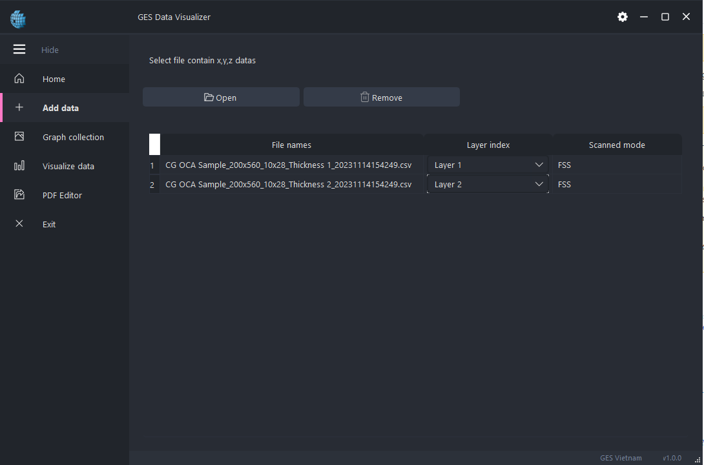
Add data tab
Indicate which sensor is used to output the selected file
File name
Category for each file, can be None or Layer 1,2,3,4

Slide 4
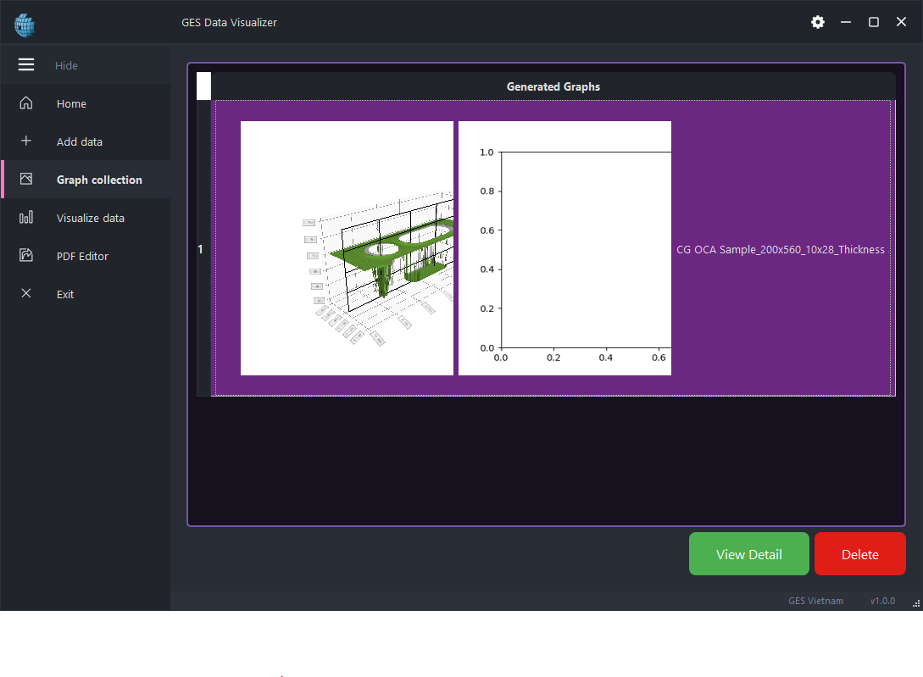
Graph collection tab
Rendered graphs will appear in this table
Delete selected graph
Open another windows for details and interaction.

Slide 5
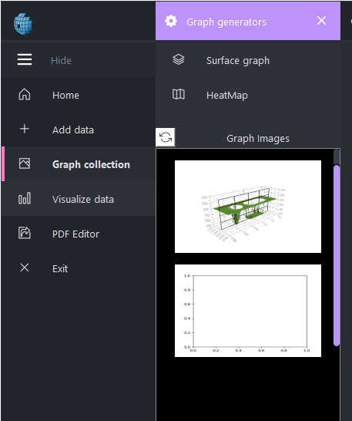
Generators panel
Generators
Graph Generators panel
Press this button to expand/collapse Graph Generators panel
Rendered images for PDF editor. These images will be automatically updated when user update graph images in Graph Detail Window.

Slide 6
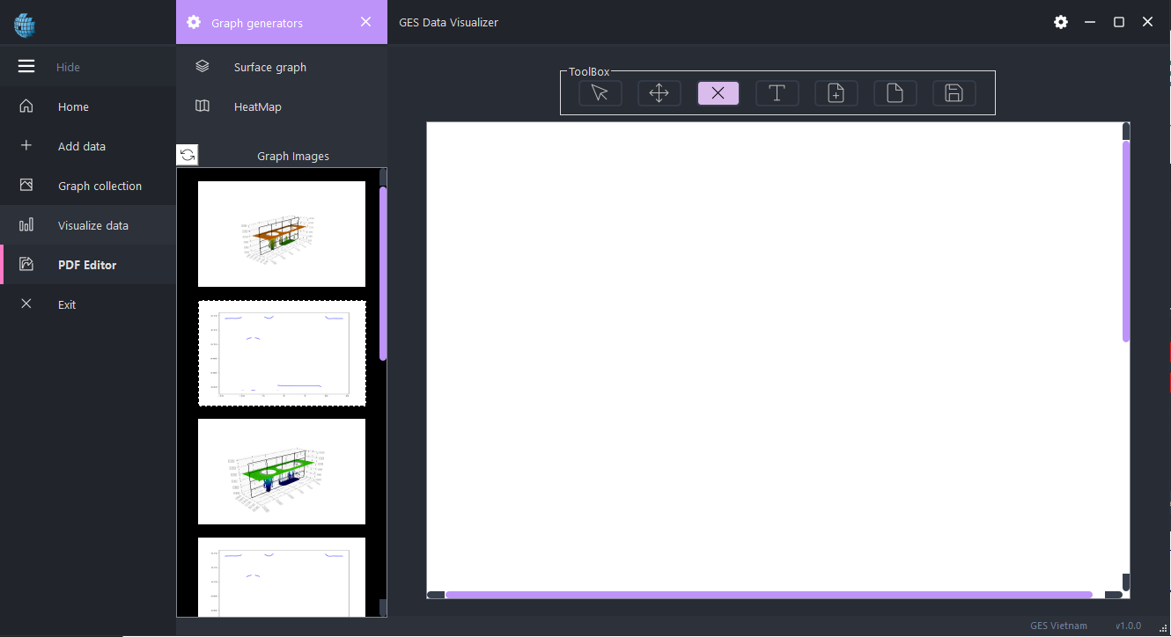
PDF editor tab
Move
Add text
Save PDF
Images to drag/drop into canvas
Remove components
Reset canvas
Editor Canvas, in A4 size format
Append 1 blank page
Normal

Slide 7
Rendering step-by-step
Select Render mode
Single layer render
Adjust Upper/Lower limits
Start render
Multi layers render
Select data for each layer

Slide 8
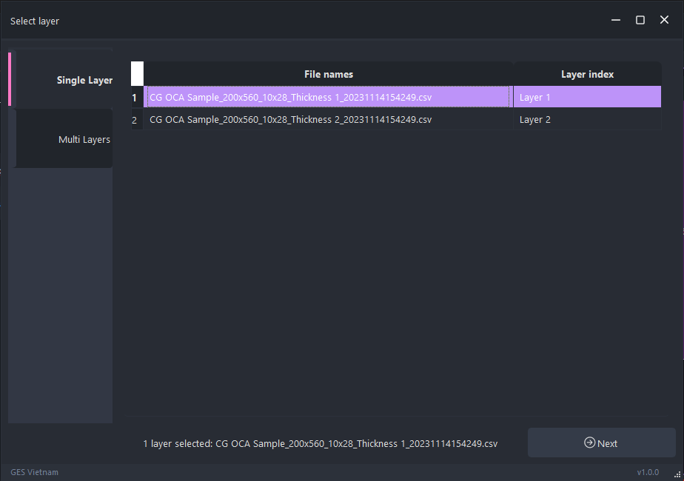
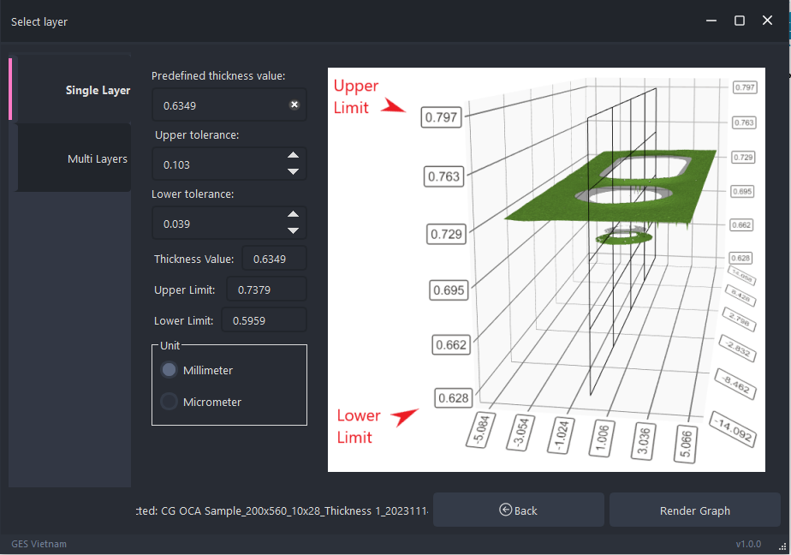
Single layer selection
Select single layer tab, choose the data file being plotted and press Next.
Adjust Upper/Lower limits and thickness value if necessary. Press Render Graph to start render when done.

Slide 9
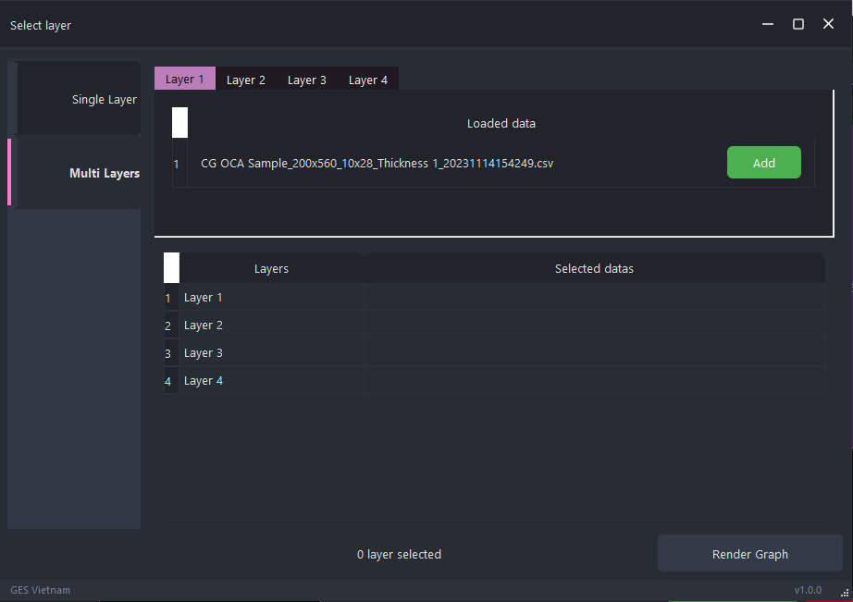
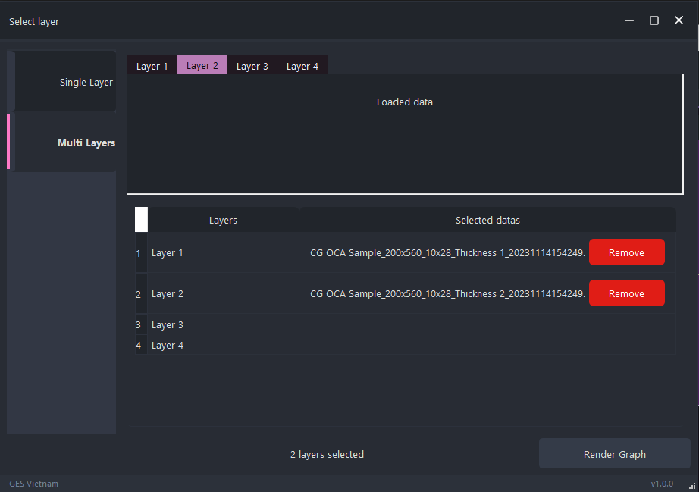
Multi layer selection
Pick one data file in each category(layer) by pressing the “Add” button next to file name.
Only 1 single file per layer is permitted. Press “Remove” to Add other data. Press “Render Graph” to start the render process when done.

Slide 10
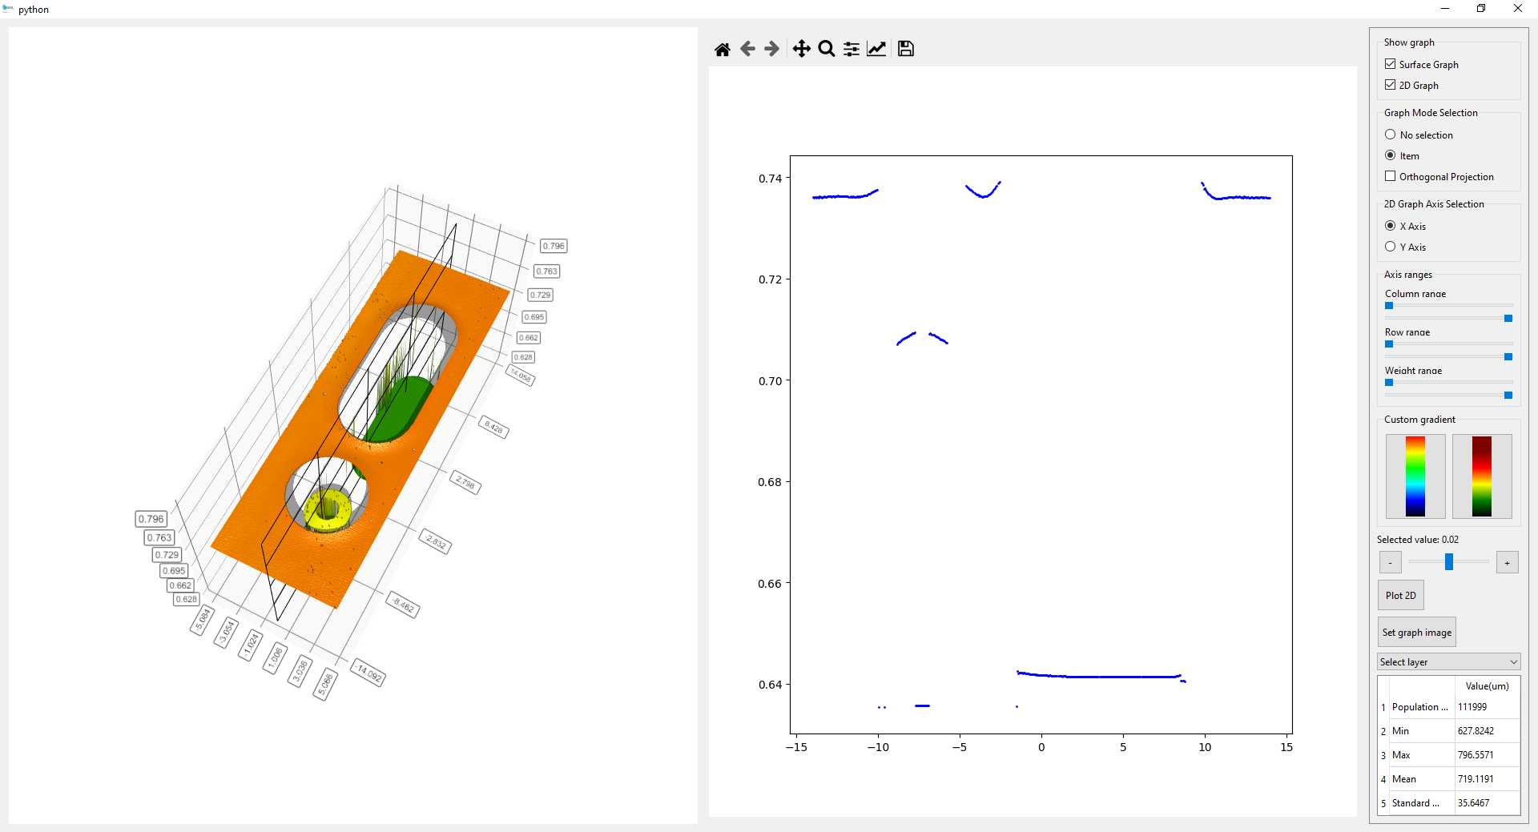
3D surface model detail window
2D graph corresponds to current slicing plane position
Rendered 3D model
- Scroll to zoom in/out.
- Press right mouse to rotate.

Slide 11
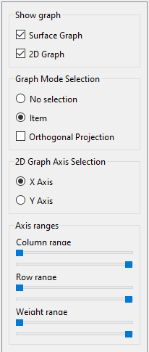
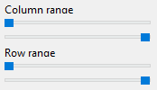

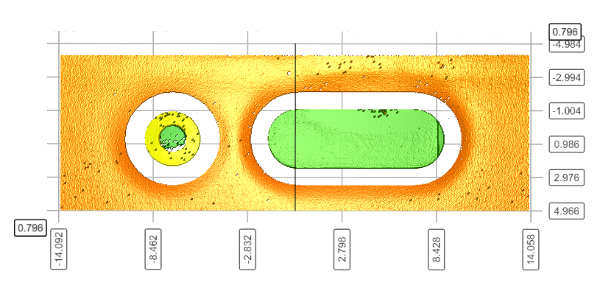

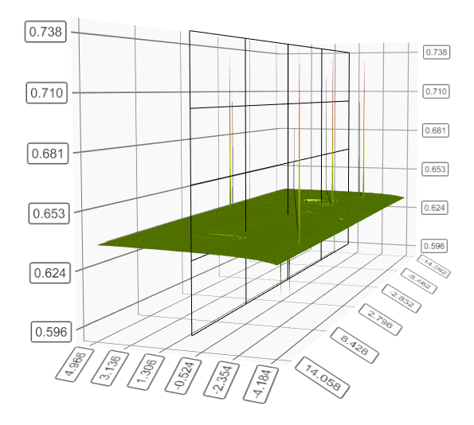
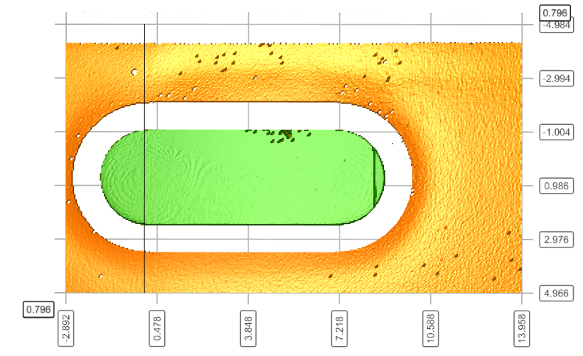

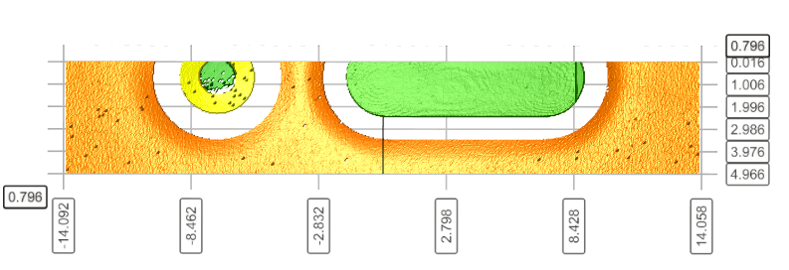

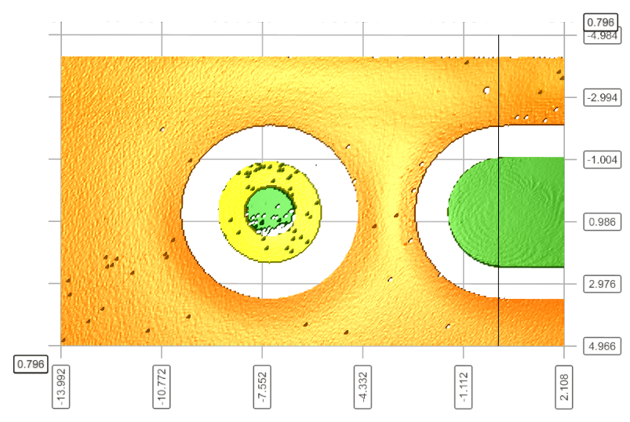

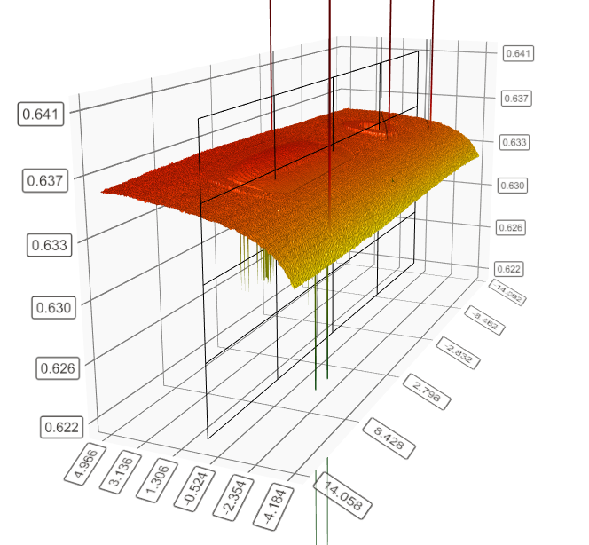

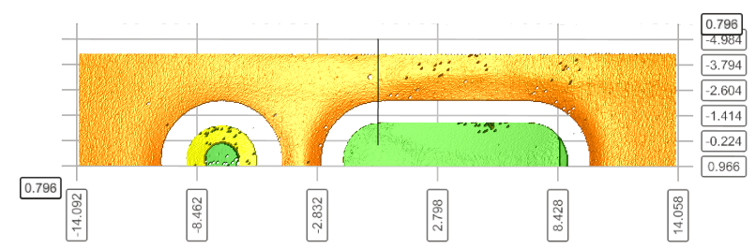
3D Model controllers panel
Item: Show point position and move slicing plane to that point on click
No Selection: Nothing happens on click
Axis to be sliced

Slide 12
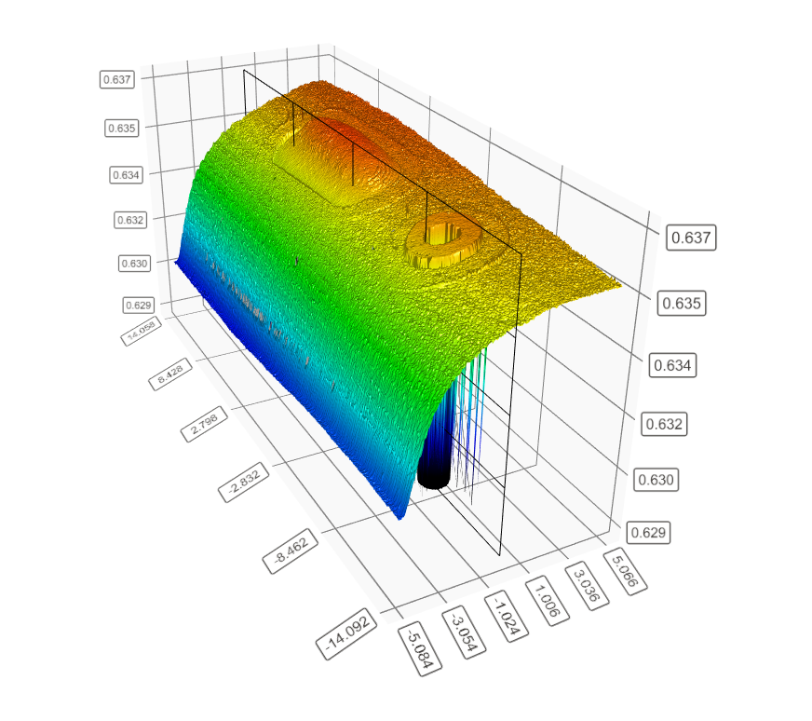
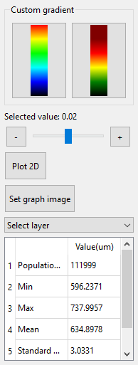
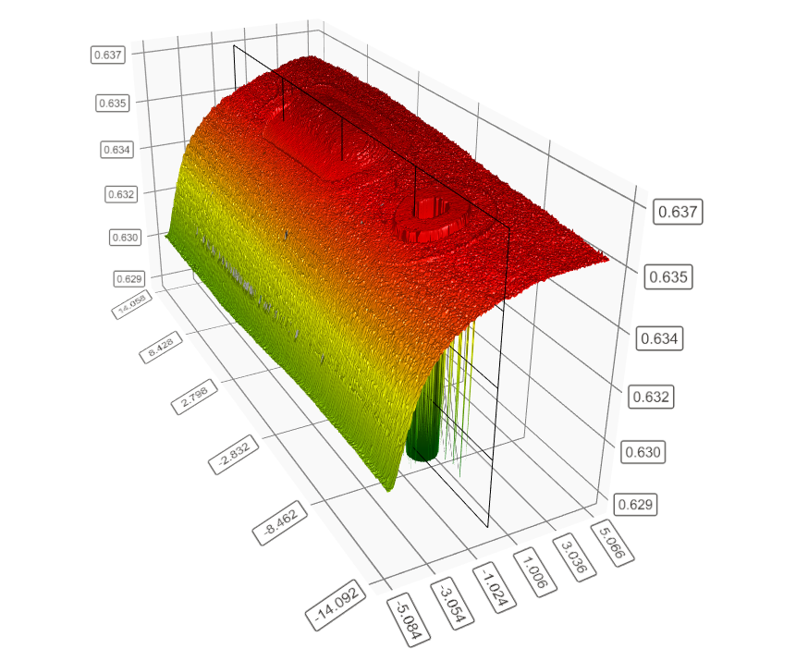
3D Model controllers panel
Slider to control the Slicing plane position
Plot 2D sliced graph with current slicing plane position
Update the corresponding images in the image container
Statistics

Slide 13
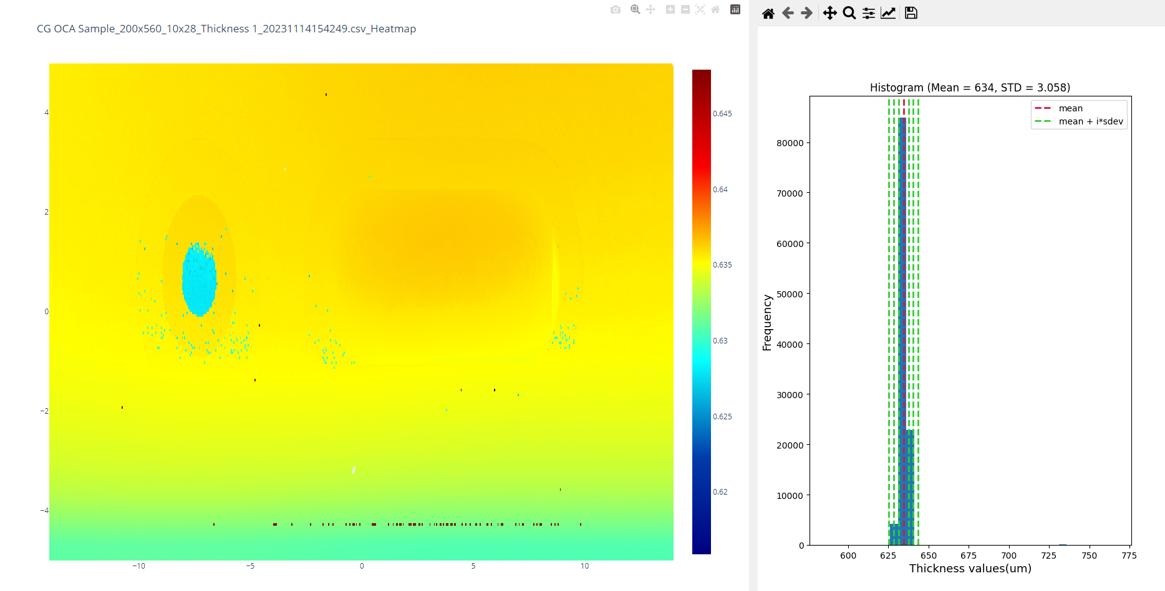
Heatmap model detail window
Heatmap
Histogram

Slide 14
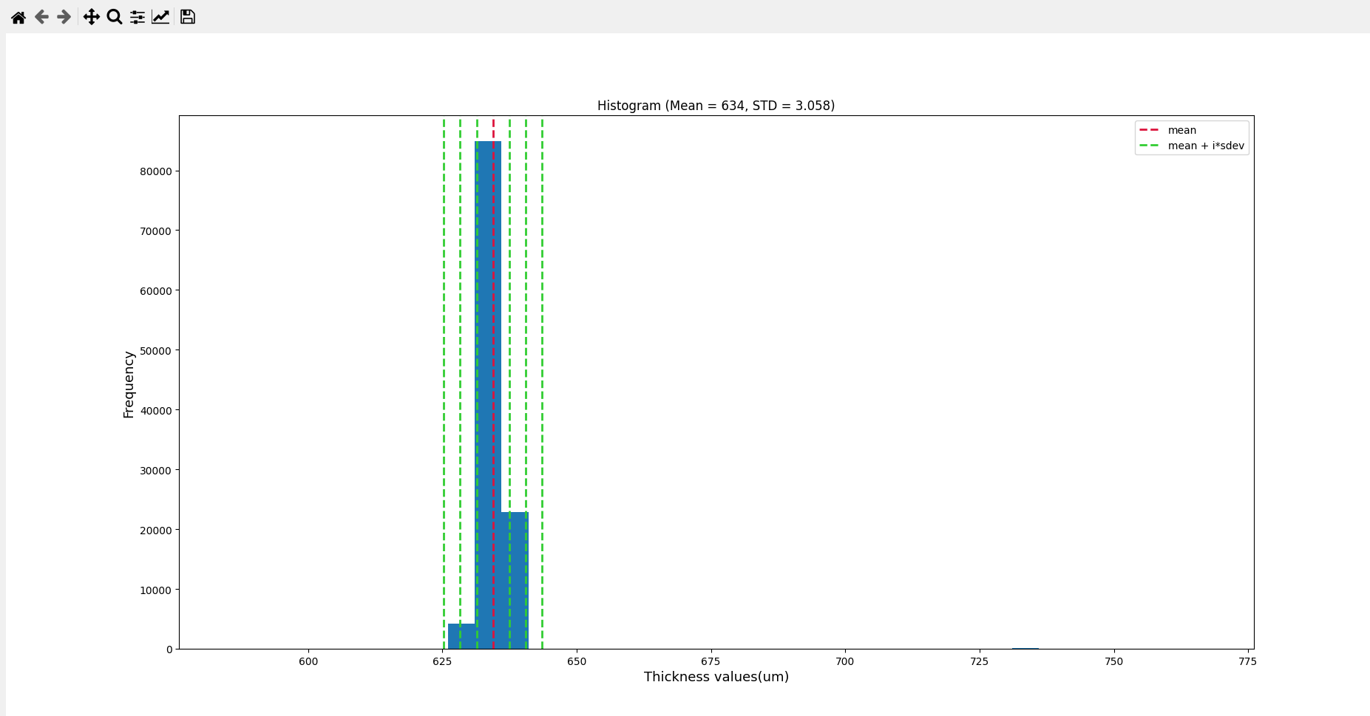
Heatmap model detail window
The histogram bin size is fixed to 5 micrometers.
The red line indicates where the mean value is.
The green lines indicate the sigma values. (Mr Hải Võ requirements)

Slide 15
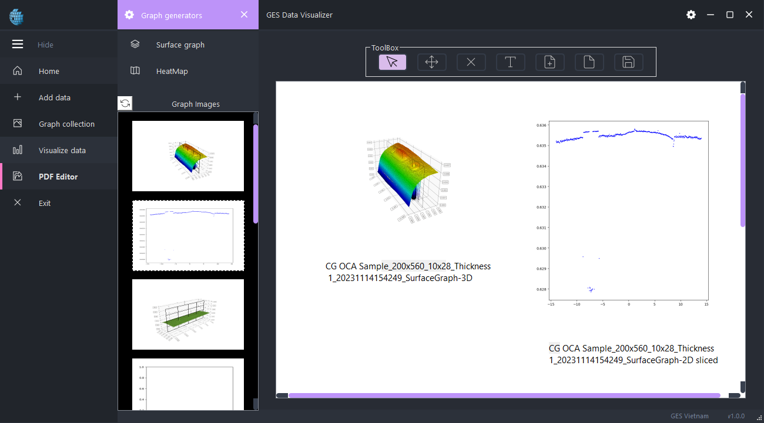
PDF Editor
2 ways to input images into canvas:
Drag and drop from Graph Images container on the left.
Drag and drop images from file explorer
To move components, simply press and move freely inside the canvas.
To remove components, click any components and press “Delete” key, or switch to remove mode and drag component into remove area at the bottom of the window.
To reset the canvas, click the blank page symbol, this will remove every components or additional pages.

Slide 16
THANK YOU

